Slide 1

Improve FPY of Hybrid soldering line
Division: DSS
Champion: Jun Liang
Powersteering ID: Six Sigma-6725
Project Belt Leader: Shangyu Guo
Team member： Liang Zhang, Xiyin Lu, Lian Zhou, Yafei Pan, Yanping Zhou, Jincheng Wan
Project Location: Oplink

Slide 2
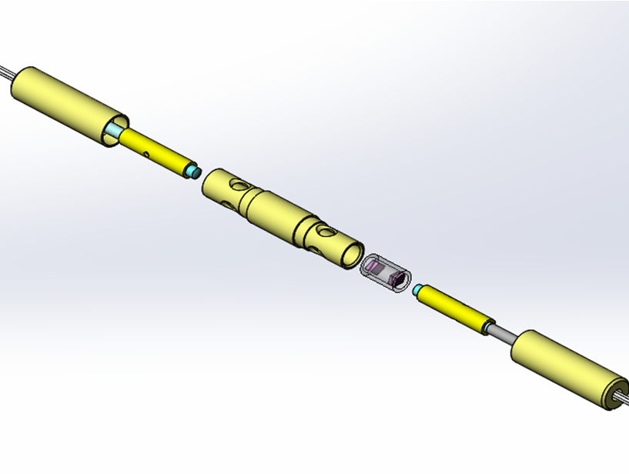
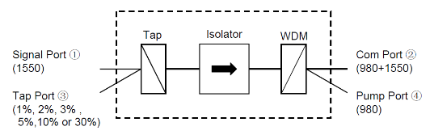
Product information

Slide 3
Executive Summary-1
Problem statement:
The current FPY of WTIH soldering product is 79% from 2015-11 to 2016-10, and it cost a lot of time to do rework.
Business Case:
Output of Hybrid soldering line from Sep. 2015 to Aug. 2016 is 1.7 million USD, about 1.2% of the company total output. WTIH soldering takes more than 80% rework number in Hybrid soldering line. The current RTY of WTIH soldering products is 79% in the last 12 months. And it's the bottom 10 product series of the passive MFG.
Objective Statement:
Improve the FPY of WTIH soldering product from 79% to 90% before 3-Mar-2017.
Improve Metrics
METRICS/RESULTS: | Original | Projected
FPY | 79% | 90%
Estimated annualized project saving: USD $ 10,363
Actual realized saving are $ 47
3
Notes:
Include the Project Champion, the Process Owner and all active team members.
If a fellow BB is assisting with the project AS A BLACK BELT, then they should be identified as such, however, if a fellow BB is assisting as a team member, then identify them as a team member here and on the Project Tracking System.

Slide 4
Executive Summary-2
Improved results
METRICS/RESULTS: | Before | Projected | Realized | Reduction
Scrap rate/FPY/Others | 79% | 90% | - | 0
The order is 1193 pcs in last 6 months, which is much less than the estimated (18k). FPY is 89% in Q4 2017
More benefits,
The test method improvement was expanded to the WDIH and other products which need to test 1550nm IL in 980nm fiber.
The improved 980 collimator process is estimating to expanded to other products.
4
Notes:
Include the Project Champion, the Process Owner and all active team members.
If a fellow BB is assisting with the project AS A BLACK BELT, then they should be identified as such, however, if a fellow BB is assisting as a team member, then identify them as a team member here and on the Project Tracking System.

Slide 5
Executive Summary-3
------Xs and Y Process flow
Define | Measure |  |  | Analyze |  |  | Improve | Control
Problem (Y) | Potential Causes (Xs) |  | Quick Win | Contents | Tool to use | Proven Cause? | Improvements | Method to maintain/control
直通率偏低 | X1 | OG154-1固化烘烤变化大 | No |  | Mann-Whitney Test | No
 | X7 | OG154-1紫外固不完全 | No |  | Mann-Whitney Test | Yes | 延长照光时间，提高胶水固化程度 | 制程文件，操作指导
 | X2 | 焊锡固化后应力释放 | No |  |  | closed
 | X3 | Pigtail双线束腰位置不一致 | No |  |  | closed
 | X4 | 截距距离不正确 | No |  | DOE | Yes | 采用最优截距调节 | 制程文件，操作指导
 | X5 | 焊接技能差异 | No |  | Kruskal-Wallis test | No
 | X6 | 准直器高低端没有对齐 | No |  | DOE | Yes | 固定1550准直器采用低端进光的方式 | 制程文件，操作指导
 | X8 | 光纤熔接损耗过大 | No |  | DOE | Yes | 测试前使用固定熔接模式将匹配的980光纤接到光源系统中 | 制程文件，操作指导

Slide 6

Executive Summary-4
------ for X1&X7 固化过程变化大
1
Before
After
Six SigmaTools
D: Perato graph
M: Detail Process Map
Box Plot
C-E diagram
A : Box Plot
Mann-Whitney test
I: Two-sample T
通过详细流程图可以了解当前工艺流程的关键细节，继而使用箱体图对过程中的数据进行对比来帮助团队更好地找到确定真正产生影响的原因以及对应的失效模式，使得改善措施更有针对性，工艺设置更加合理。
N Mean StDev SE Mean
改变前变化量 15 0.0861 0.0732 0.019
改变后变化量 20 0.0285 0.0591 0.013
参数名称 | 失效比例 | 预估改善后失效比例
980MaxIL | 7.64% | 4.02%？

Slide 7
Hypothesis test for X1 (Y1) (Analyze)
H0: there is no difference between the reflective IL of collimator before baking and after baking.
Ha: there is difference between before baking and after baking.
Mann-Whitney Test and CI: 焊前, 固化前
N Median
焊前 11 0.3700
固化前 11 0.2600
Point estimate for η1 - η2 is 0.0800
95.1 Percent CI for η1 - η2 is (0.0400,0.1300)
W = 167.5
Test of η1 = η2 vs η1 ≠ η2 is significant at 0.0078
The test is significant at 0.0077 (adjusted for ties)
Conclusion: Reject H0, there is significant difference between the reflective IL of collimator before baking and after baking.

Slide 8
Hypothesis test for X1 (Y1) (Analyze)
H0: there is no difference between the reflective IL of collimator before baking and after baking.
Ha: there is difference between before baking and after baking.
Conclusion: Reject H0, there is significant difference between the reflective IL of collimator before baking and after baking.
Analysis of Variance
Source DF Adj SS Adj MS F-Value P-Value
Factor 3 0.06158 0.020528 5.74 0.002
Error 56 0.20037 0.003578
Total 59 0.26195

Slide 9
Data collection for X1 (Y1) (Analyze)
Hypothesis for 1550 collimator
N Median
照光后_3 15 14.830
热烘烤后_1 15 14.900
Point estimate for η1 - η2 is -0.050
95.4 Percent CI for η1 - η2 is (-0.160,0.060)
W = 200.0
Test of η1 = η2 vs η1 ≠ η2 is significant at 0.1844
The test is significant at 0.1838 (adjusted for ties)
N Median
调节_1 893 5.4000
焊接_2 903 5.4260
Point estimate for η1 - η2 is -0.0180
95.0 Percent CI for η1 - η2 is (-0.0230,-0.0130)
W = 721172.0
Test of η1 = η2 vs η1 ≠ η2 is significant at 0.0000
The test is significant at 0.0000 (adjusted for ties)
Conclusion: 1550 IL of 照光后 and 焊接前 have no difference, 95% CI of IL change is -0.013~-0.023.

Slide 10
Data collection for X1 (Y1) (Analyze)
Hypothesis for PM collimator
Two-sample T for 照光后_2 vs 下架
N Mean StDev SE Mean
照光后_2 20 12.7065 0.0790 0.018
下架 20 12.7090 0.0827 0.018
Difference = μ (照光后_2) - μ (下架)
Estimate for difference: -0.0025
95% CI for difference: (-0.0543, 0.0493)
T-Test of difference = 0 (vs ≠): T-Value = -0.10
P-Value = 0.923 DF = 38
Both use Pooled StDev = 0.0809
N Median
准直器调节 1817 3.2000
焊接 1817 3.2300
Point estimate for η1 - η2 is -0.0300
95.0 Percent CI for η1 - η2 is (-0.0400,-0.0300)
W = 2812556.0
Test of η1 = η2 vs η1 ≠ η2 is significant at 0.0000
The test is significant at 0.0000 (adjusted for ties)
Conclusion: 1550 IL of 照光后 and 焊接前 have no difference, 95% CI of IL change is -0.03~-0.04.

Slide 11
Data collection for X1 (Y1) (Analyze)
Hypothesis for PD collimator
Analysis of Variance
Source DF Adj SS Adj MS F-Value P-Value
Factor 3 0.1066 0.035528 11.79 0.000
Error 72 0.2169 0.003013
Total 75 0.3235
Factor N Mean StDev 95% CI
照光前IL 19 0.38421 0.03863 (0.35911, 0.40931)
照光后IL 19 0.4105 0.0448 ( 0.3854, 0.4356)
紫外烘烤后的IL 19 0.4705 0.0784 ( 0.4454, 0.4956)
烤箱烘烤后的IL 19 0.3742 0.0490 ( 0.3491, 0.3993)
N Median
调节 89 0.13000
焊接_1 89 0.16000
Point estimate for η1 - η2 is -0.03000
95.0 Percent CI for η1 - η2 is (-0.04000,-0.01999)
W = 6217.5
Test of η1 = η2 vs η1 ≠ η2 is significant at 0.0000
The test is significant at 0.0000 (adjusted for ties)
Conclusion: Reject H0, there is significant difference between the reflective IL of collimator before baking and after baking.

Slide 12
Executive Summary-4
------ for X1 固化过程变化大
1
Before
After
Six SigmaTools
D: Perato graph
M: Detail Process Map
Box Plot
C-E diagram
A : Box Plot
Mann-Whitney test
I: Two-sample T
通过详细流程图可以了解当前工艺流程的关键细节，继而使用箱体图对过程中的数据进行对比来帮助团队更好地找到确定真正产生影响的原因以及对应的失效模式，使得改善措施更有针对性，工艺设置更加合理。
N Mean StDev SE Mean
改变前变化量 15 0.0861 0.0732 0.019
改变后变化量 20 0.0285 0.0591 0.013
参数名称 | 失效比例 | 预估改善后失效比例
980MaxIL | 7.64% | 4.02%？

Slide 13
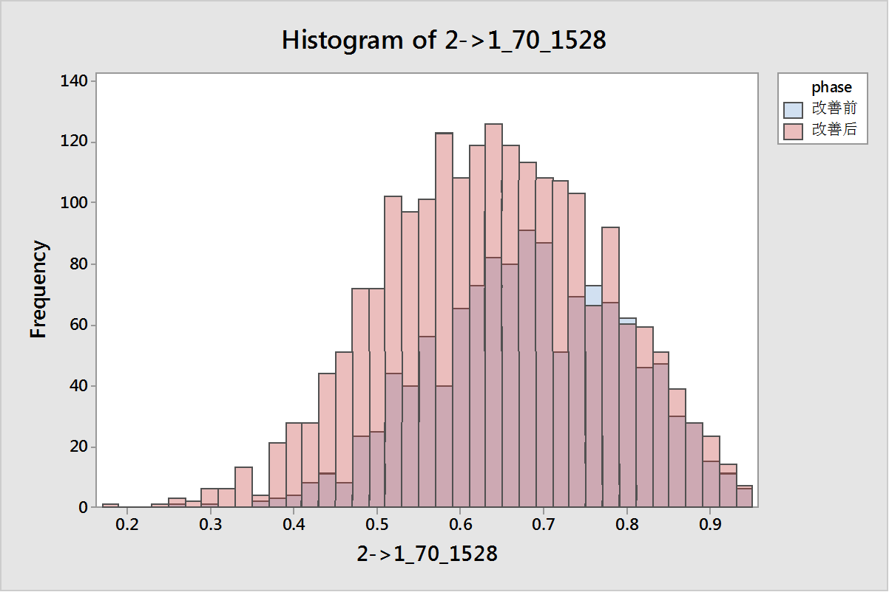
Executive Summary-4
------ for X8 光纤熔接损耗过大
1
Before
Six SigmaTools
After
D: Perato graph
M: Detail Process Map
Histrogram
C-E diagram
A : DOE
通过详细流程图可以了解当前工艺流程的关键细节，继而使用设计实验来帮助团队更好地找到确定真正产生影响的原因以及对应的失效模式，使得改善措施更有针对性，工艺设置更加合理。
参数名称 | 失效比例 | 改善后失效比例
WDIH | 1.4% | 0.6%
WTIH | 7.03% | 3.09%?
改善前
改善后

Slide 14
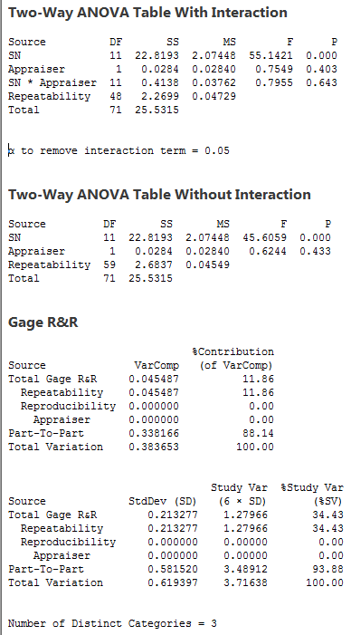
MSA-1550透射IL
Repeatability is the key problem of this test system.

Slide 15
MSA-Hypothesis analysis
Test for X6, X7, X8 for 11400004_Y01G
Conclusion： for the 11400004_Y01G fiber, 3 factors are important issue.

Slide 16
MSA-Hypothesis analysis
Test for X6, X7, X8 for 11400004_Y01G
1550 Laser
SMF28e
11400004_Y01G
SMF28e
Power Meter
Conclusion： for the 11400004_Y01G fiber, 熔接模式 are important issue.

Slide 17
Executive Summary-4
------ for X8 光纤熔接损耗过大
1
Before
Six SigmaTools
After
D: Perato graph
M: Detail Process Map
Histrogram
C-E diagram
A : DOE
通过详细流程图可以了解当前工艺流程的关键细节，继而使用设计实验来帮助团队更好地找到确定真正产生影响的原因以及对应的失效模式，使得改善措施更有针对性，工艺设置更加合理。
参数名称 | 失效比例 | 改善后失效比例
WDIH | 1.4% | 0.6%
WTIH | 7.03% | 3.09%?
改善前
改善后

Slide 18
项目心得
1
详细流程图能够帮助我们清楚了解当前实际工艺流程的关键细节，配合以数据图表能够帮助团队更快地找出问题发生的关键位置。
假设检验能够以更加科学的方式帮助团队确认问题的原因。
设计实验能够以较低的试验成本来获得我们需要确认的原因。

